Slide 1
PROJECT ENABLER
Business Case
by Pablo Gómez

Slide 2
Table of contents
Context
Development
Discussion
1. Starting data
2. Assumptions
1. Main KPIs
2. Python behind the scenes
3. Sample data
1. Potential next steps

Slide 3
Context

Slide 4
Starting data
Analyse of the provided info
Description of the overall process

Slide 5
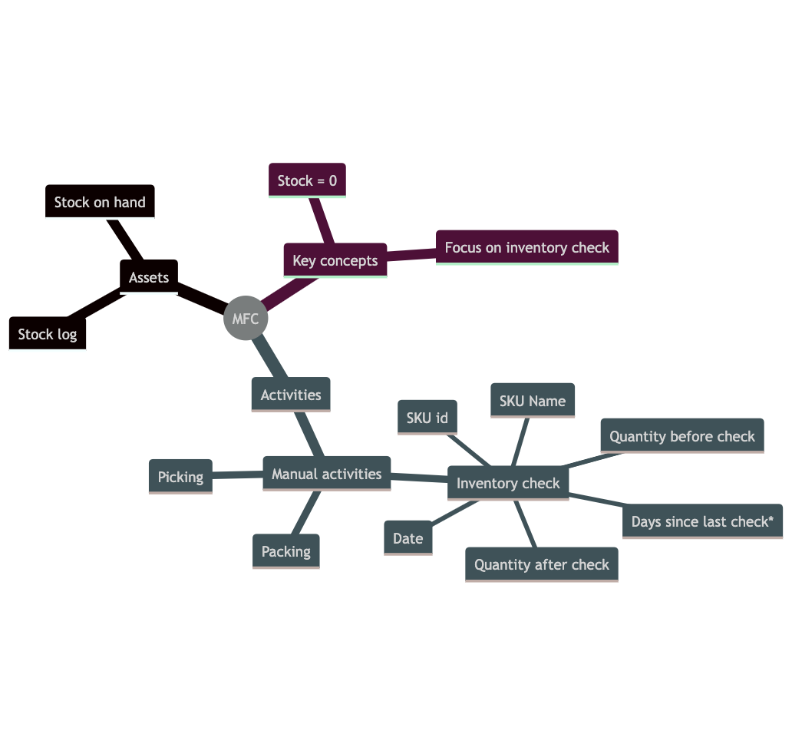
Context
MFC’s SKU List
Current Stock
Movement stock
¡Inventory check updates it!
Activities
Picking & Packing
Inventory check
KPIs focus on this activity
Constraints
Stock = 0 means not offered.
Focus on inventory check

Slide 6
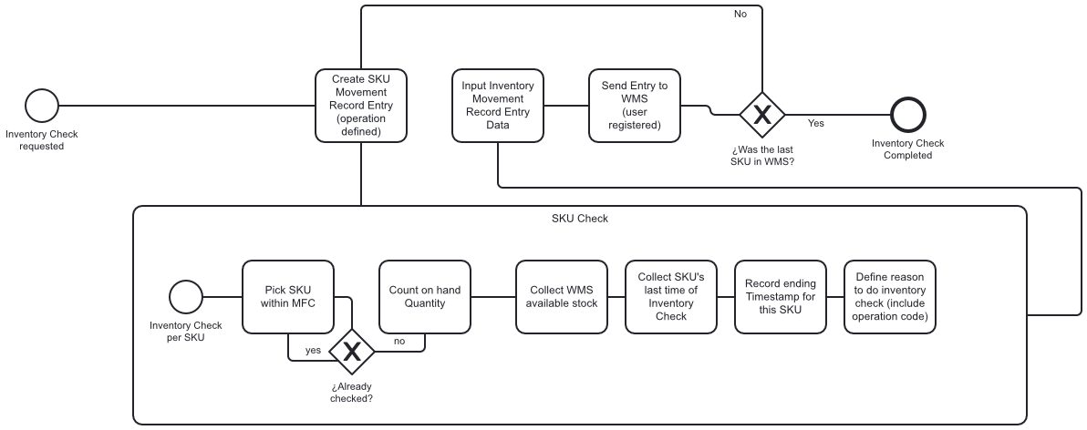
Context - Inventory Check basic Process Model

Slide 7
Assumptions
Data available
Out of scope but relevant data.

Slide 8
No stock control
No access to complaints
30 minutes
We focus only on “inventory check” activity
We assume customers always complain and expect to receive their items (better late than never).
to check the first item.

Slide 9
FTE cost = €10/hr.
Maverick check
€10 SKU worth
Everyone at our MFC’s has the same wage.
We assume employees do not do “surprise” checks.
To make it easier to “catch value”, all SKUs are worth €10.

Slide 10
Development

Slide 11
Main KPIs
# Inventory checks
Time since inventory check
Time to fulfil inventory check
Stock deviation
Rework

Slide 12
¿How many times we have done inventory check?
¡Not enough!

Slide 13
# Inventory Checks
Knowing the number of inventory checks an MFC has done is crucial for accurate inventory tracking, correcting manual error, and regulatory compliance.
Understanding why we fulfil a check is also helpful to understand what we are doing:
Complaints → Refund due to SKU not available.
Business Rule / Compliance → Practice to control stock.
Maverick Checking

Slide 14
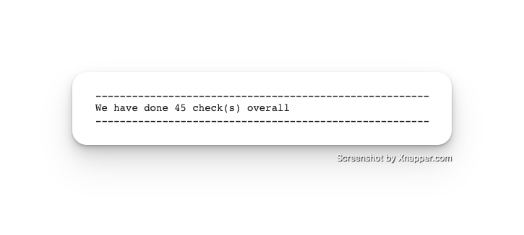
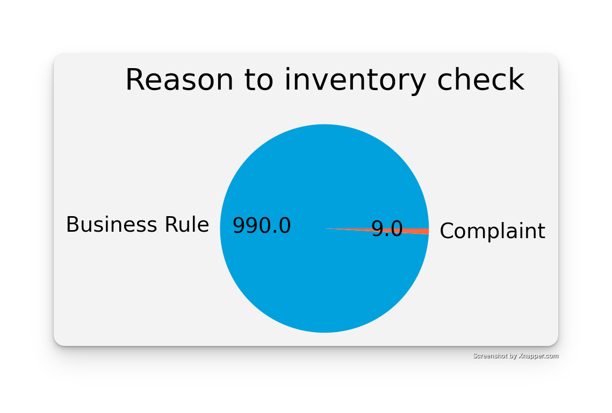
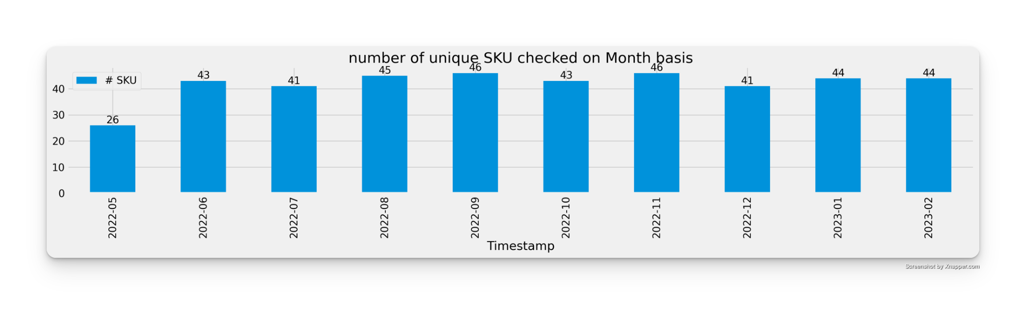
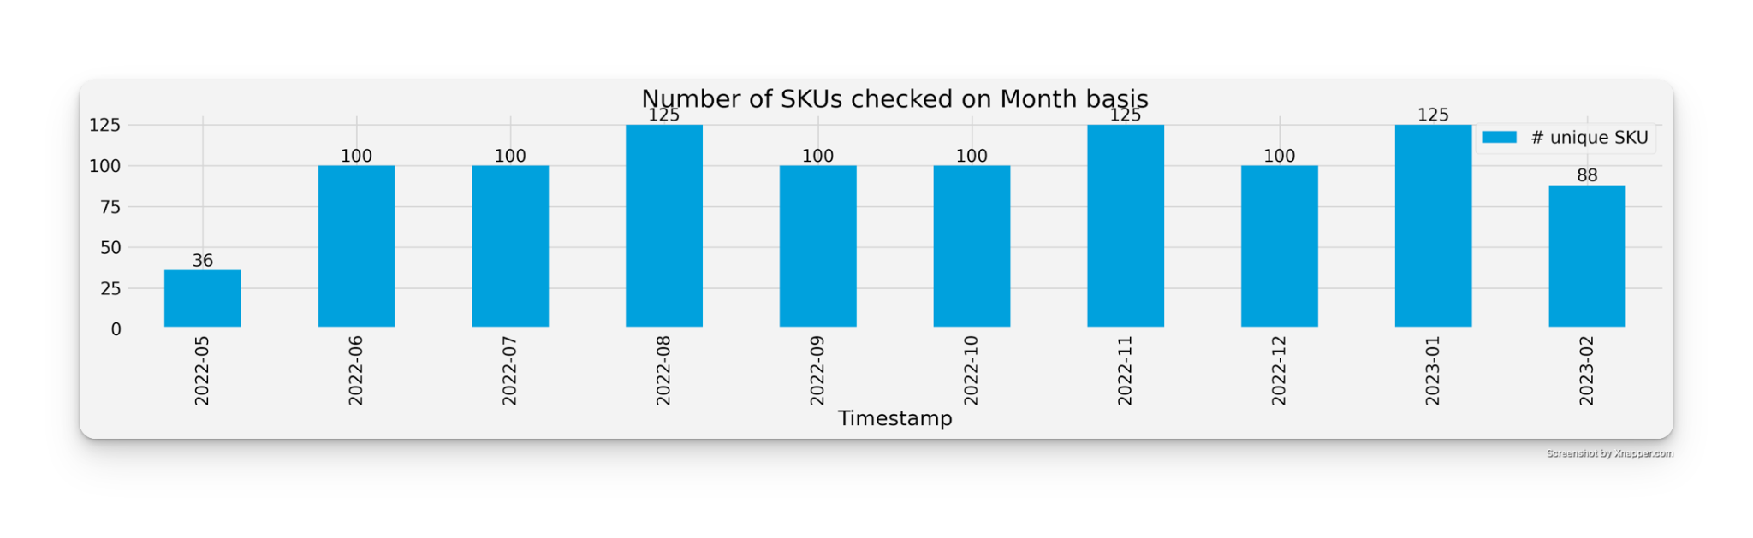
Frequency of inventory check
Overall checks
Reasons to do inventory check
Unique SKU checked
Items check across unit

Slide 15
¿When did we last check our stock?
We haven’t in a long time…

Slide 16
Days since last Inventory Check
Knowing the time since the last inventory check helps ensure accurate inventory levels and avoids stock outs or overstocking. It also helps identify potential issues in the inventory management process and supports efficient operations.
If the time between executions is smaller than our current time, it means: ¡it is time to do a check!

Slide 17
Time spent checking inventory
Knowing the time spent on inventory checks helps with resource planning, process optimization, and identifying opportunities for efficiency gains. It also helps in measuring and improving overall operational performance.
Assumption: The first registry takes 30 minutes approximately

Slide 18
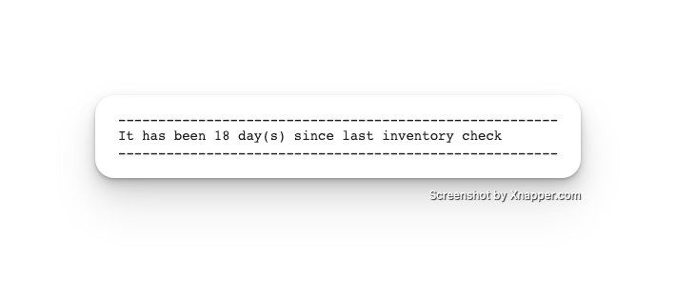
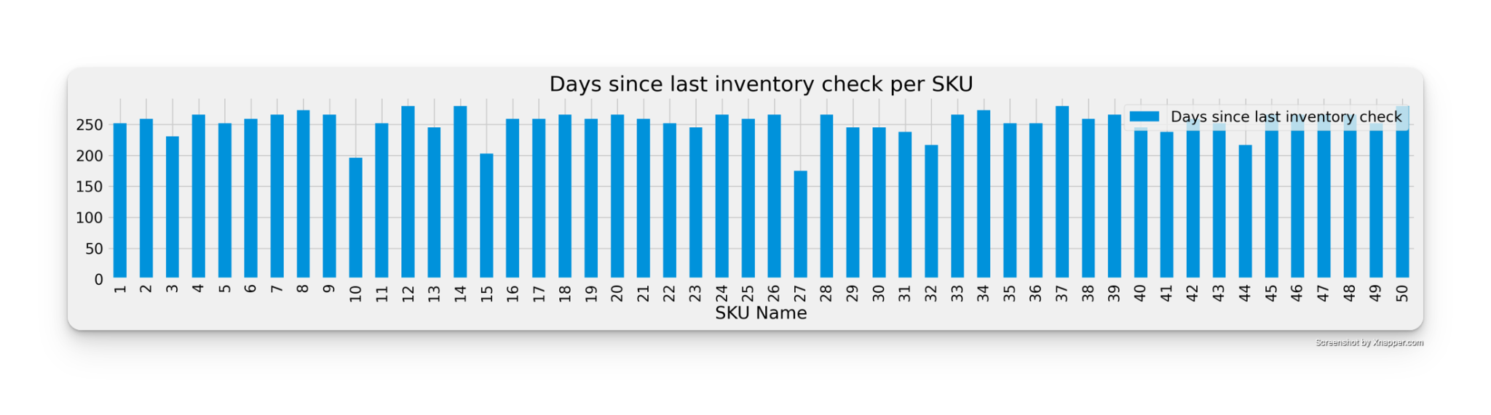
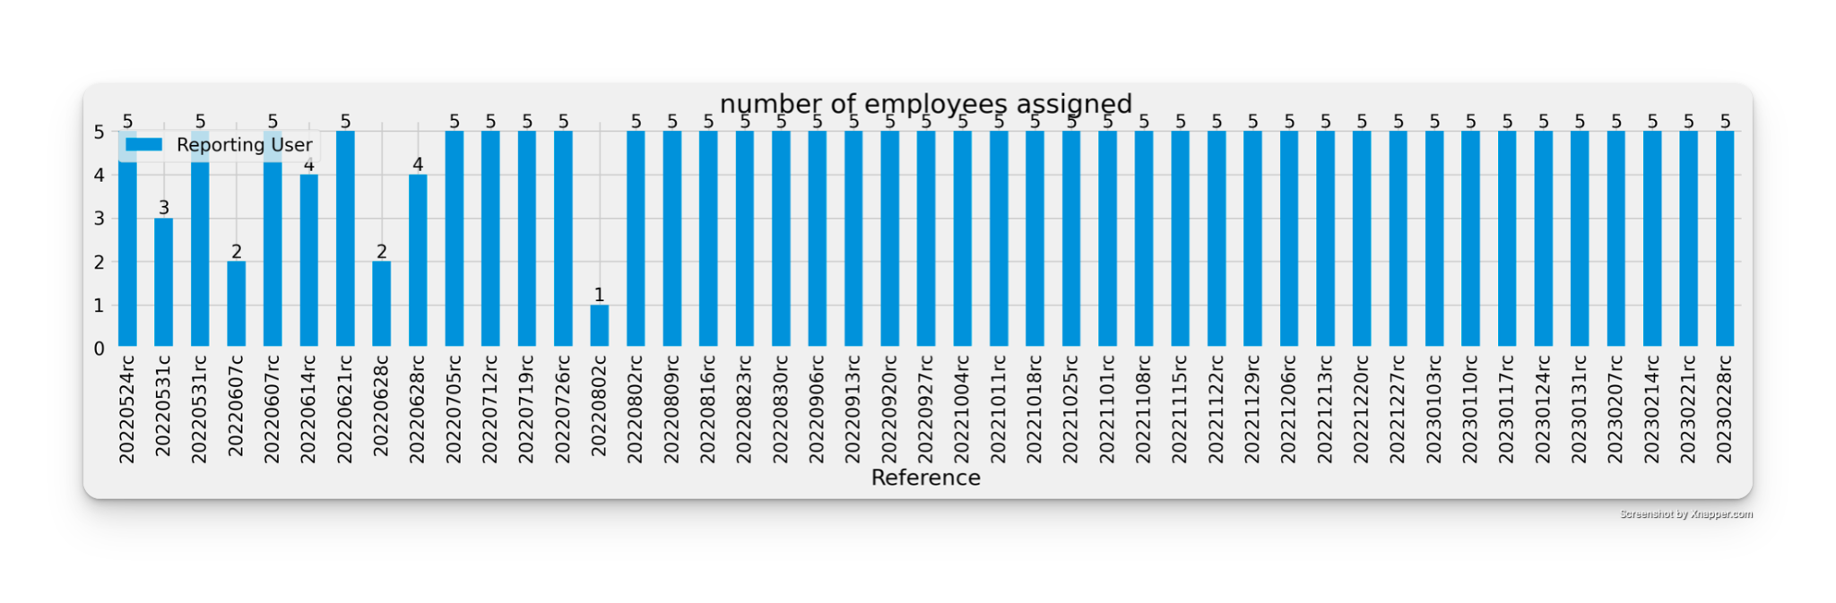
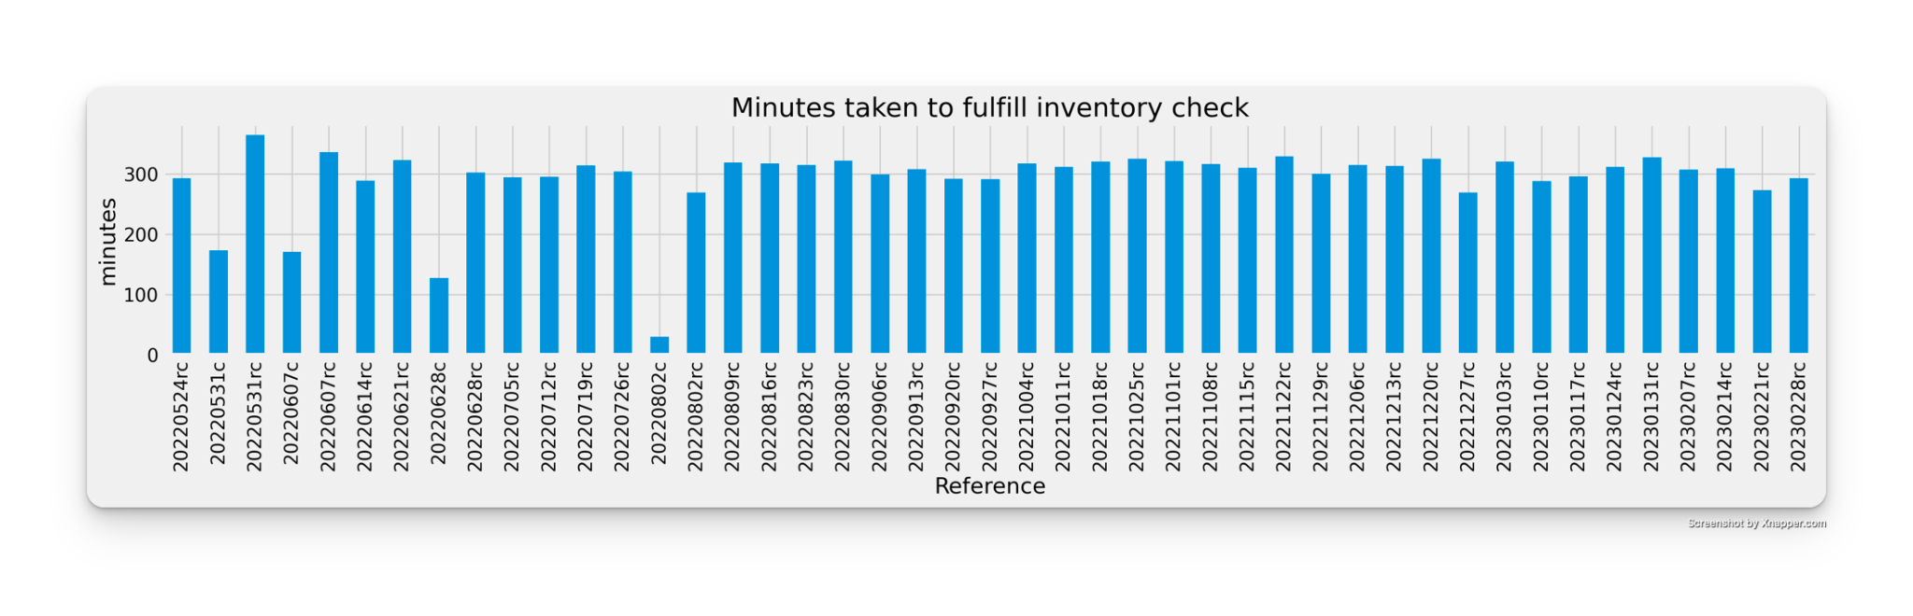
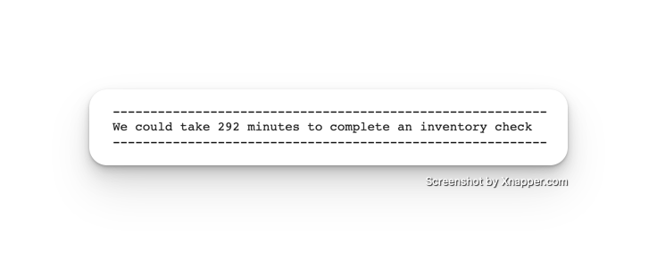

Keeping the velocity on check
Time since last inventory check
Days since last check (per SKU)
Time to fulfil inventory check
Number of employees per inventory check
Assume FTE cost:
292 minutes * 5 people * €10/hr * 1 hr/60 min ≈ €243

Slide 19
We should have that item… ¿Right?
The WMS states we should have this item… ¿Shouldn’t we?

Slide 20
Cases without stock in-hand
Customers will complain if they buy something not available, and we need to refund them because that item is not available. This is also a direct non-desired activity as it causes 2 invoices.
For that, we can do an average of # cases where WMS stock ≠ 0 but inventory states = 0.

Slide 21
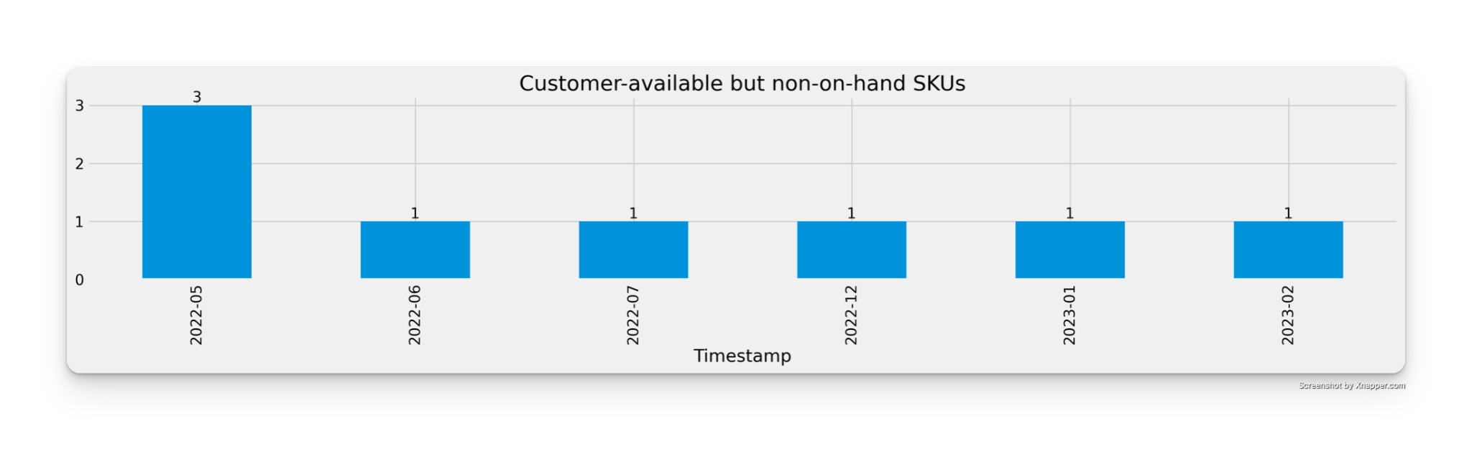

Cases without stock in-hand
Assume FTE cost and 1 hour to cover 2 invoices (sell and refund):
8 cases * €10/hr * 1hr/case ≈ €80

Slide 22
Customer-disabled but available SKUs
We may have had an error whilst packing and our customers could not have claimed it. This leads to have items we can’t sell as they report as not available. Once the inventory is done, it is feasible to sell it - as we report stock available.
Assumption: Customers did not complain about missing stock.

Slide 23
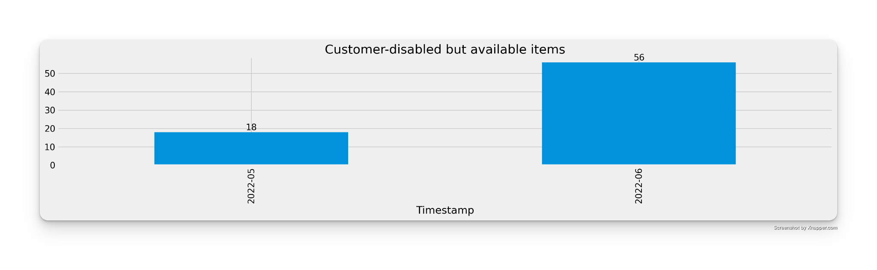

Customer-disabled but available SKUs
Assume FTE cost and 1 hour to cover not sent items after all and 2 employees (MFC pack responsible and carrier):
74 cases * €10/case * 2 employees ≈ €1480

Slide 24
Customer-enabled but quantity-deviating SKUs
It is important to know how many cases we have been able to “prevent” from not selling or even worse: having to refund their worth.
Thanks to this value, we can catch those mistakes early and recognize this task worth to the team.

Slide 25
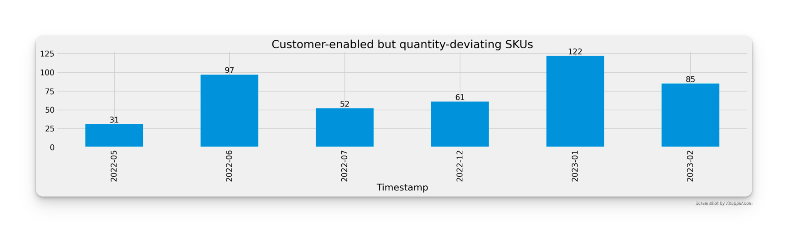
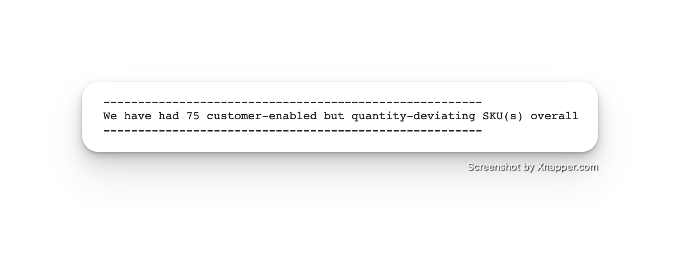
Customer-enabled but quantity-deviating SKUs

Slide 26
I just checked that SKU
And other ways to explain rework

Slide 27
Rework
We should avoid checking twice the same day the same SKUs, as it leads to trust issues within our employees and, hopefully, validate the data we already checked

Slide 28
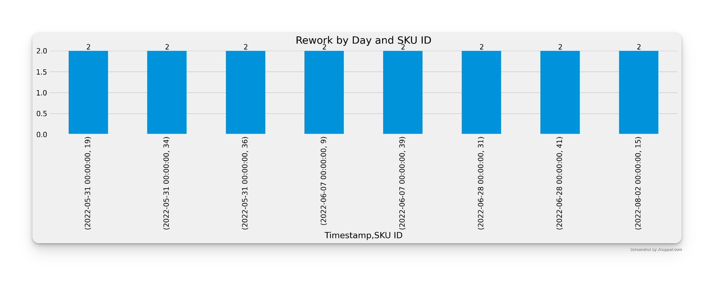
Rework
Assume FTE cost and X as the time needed to check a single SKU:
8 cases * €10/hr * 1 employee/case * X hr ≈ €80X

Slide 29
Python behind the scenes
Access to code
Analyse of each metric given (Optional)
Part B

Slide 30

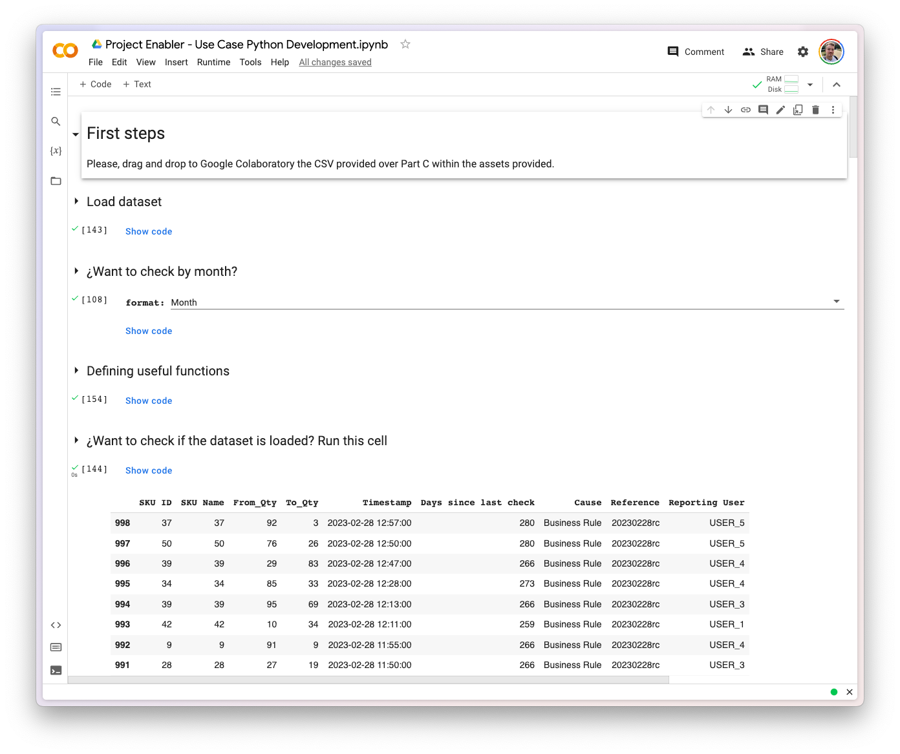
Jump into Python Script
(link to Google Colab)

Slide 31
Sample data
Access to Spreadsheet
(Optional) Additional columns requested

Slide 32

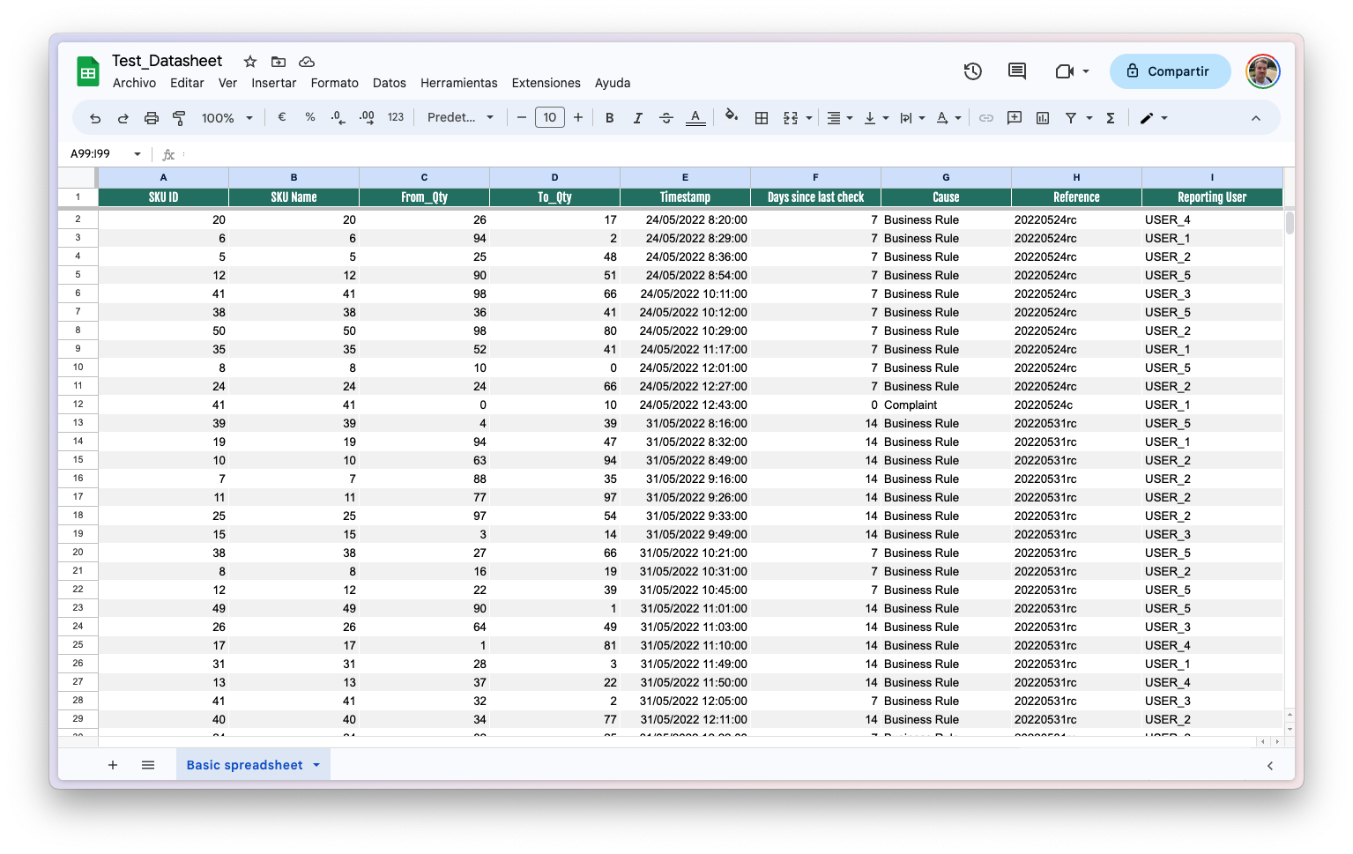
Spreadsheet
(link to spreadsheet)
Making it easier to parse…
Days since last check is based on the dataset to make easy-to-read python code.
Understanding why
“Cause” and “Reference” provide data to identify when did we do something and who sponsors it.
Reporting user
Though it is a bad idea to report names, we should know how many FTE contributed or if it was automatic

Slide 33
Discussion

Slide 34
Potential next steps
Improvement Plan
Potential data points to keep improving

Slide 35
Improvement plan
Set goal %
Suggested 20%
(≈€400)
€1993 captured
Elaborate plans
Average cost of activity
+
Non-conformant cases
Check potential actions

Slide 36
Potential next data points
Claims
We should know if we can sell 2 times the same article due to an error.
Item control
Product details
Add logs for sales and returns.
Provides scope of time for lost items and can check what happened.
To capture value, we should know how much an item is worth.

Slide 37
¡Thanks!
Do you have any questions?
pgomezponce@gmail.com
+34 644 11 01 40
linkedin.com/in/pablogomezponce

